Slide 1
HomeTOWN happenings!
By Mary Ruthven & Annie Zeng

Slide 2

Do you ever find yourself bored while in your hometown?
Are you constantly wishing that there was something exciting to do?
Places to be? People to see? Experiences to be had?

Slide 3
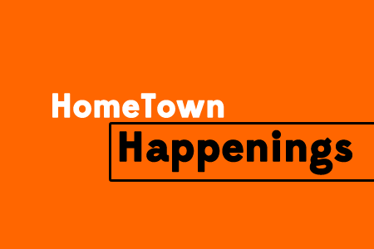

THE HOMetown Happenings Android App
Get updated feeds about exciting events happening everyday!
Add events to this stream!

Slide 4
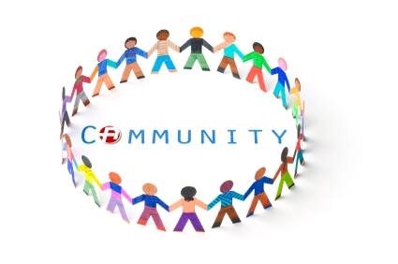
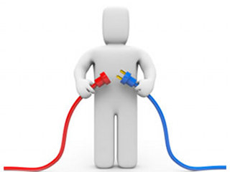

I’m so involved!!!

Slide 5
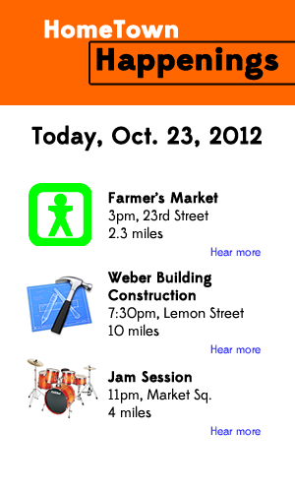
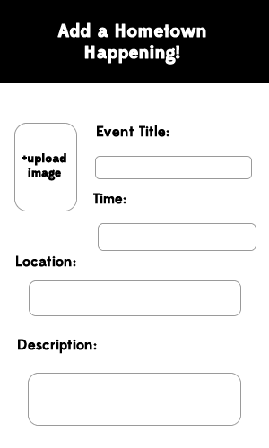
Initial WireFrames
Home page
Add event page

Slide 6
APP Demo time!!!

Slide 7
future goals:
Access information from databases
Put database on the internet
Add a calendar of events
Be able to upload images from phone

